Slide 1
SQL Server and Network Study Setup, Troubleshooting & Training
INTERNAL DSI USE ONLY!
July 2011

Slide 2
What is SQL?
SQL stands for Structured Query Language
  Designed to manage data in a relational database management systems (RDBMS)
SQL Server are products offered by Microsoft
  Many versions and platforms available
Others that support RDBMS
  Oracle, Sysbase, MySQL…
Ponemah uses free versions of Microsoft based SQL Servers

Slide 3
What is SQL Server Used For
P3 Application database
  Stores most of the global settings
Study Databases
  Must use Study
  All Study related data

Slide 4
SQL Server Databases Supported
MSDE2000 (SQL Server Desktop 2000)
  P3 V4.3 or better
SQL Server Express 2005
  Started with P3 V4.9
    Only on new install, if upgrading Ponemah than MSDE2000 that is on the workstation will be used.
TruData – SQL Server Express 2008
  Future product – not in this presentation

Slide 5
Ponemah \ SQL Server Version Chart
Ponemah Version | SQL Version | Install Method | Notes
V4.2 | MSDE2000 | Separate for each instance | Only for Ponemah application related data, no Study related data.
V4.3 – V4.5 | MSDE2000 | Separate for each instance | Added Study data, not networked
V4.6 | MSDE2000 | Integrated with application install | Added workstation names but not networked study capable.
V4.7 – V4.8 | MSDE2000 | Integrated with application install | Network study capable
V4.9 and above | SQL Server Express 2005 | Integrated with application install | Uses MSDE2000 if upgrading Not backwards compatible if backing up and then restoring on older version. NOTE: Windows 7 is not compatible with MSDE.

Slide 6
Notes for SQL Server Installations
For the integrated install the user must have administrative rights the first time Ponemah is launched since this will create the initial P3 database.
If the instance P3PlusTest is selected in the future the user must have administrative rights the first time that instance is entered.

Slide 7
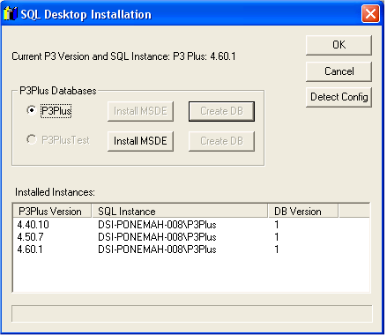
Installations V4.5 and Prior
Separate application to install SQL Server 2000 (MSDE)

Slide 8
Definitions
SQL Instance
  Different from a database. This is a separate data store for databases files.
  Same database names (Study) can exist in each instance but with different data.
SQL Database
  Replace data files with a robust method of storing data.
  Completely managed by SQL Server and Ponemah application.
    No user interaction directly with the database

Slide 9
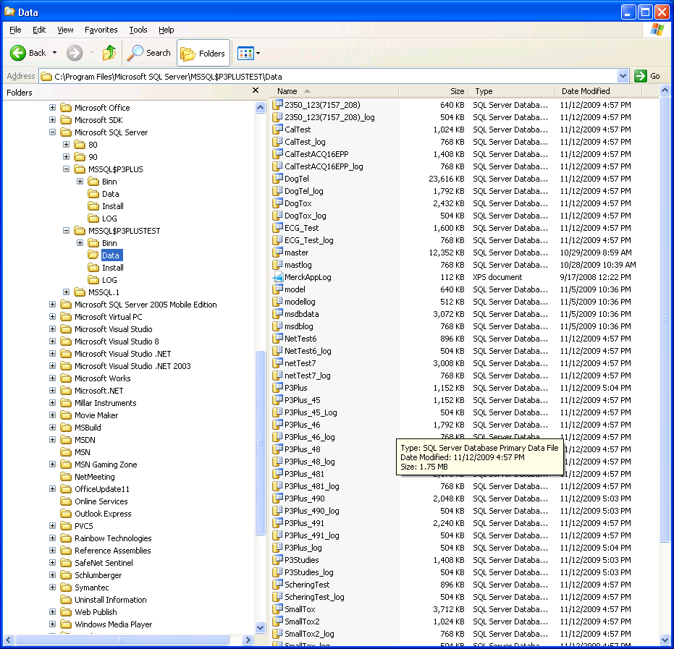
SQL Server 2000 Instance & File Layout
Instance 1: P3Plus
Instance 2: P3PlusTest
Different versions of Ponemah installed noted by database filename.
Each Study has it’s own database (files). 2 files per database.
Notes:
MDF extension is the main database file
LDF is the SQL internal audit log file

Slide 10
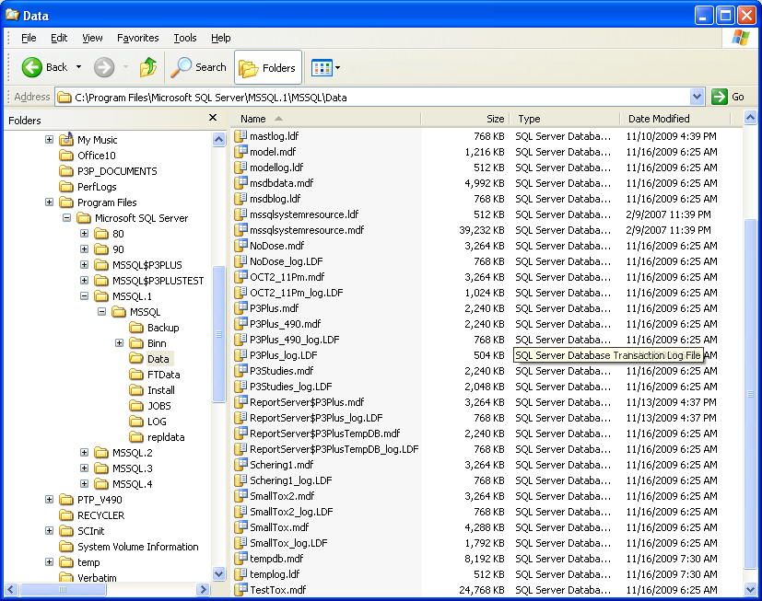
SQL Server 2005 Instance & File Layout
Instance 1: P3Plus which is under the MSSQL.1 folder
Notes:
File layout for database the same
Instance name different

Slide 11
SQL Server 2005 Instances
Instance number for Ponemah could be different if another application installed SQL Server 2005 Express first
  Example: CRM
Only way to know for sure is by looking in the SQL Data folder.

Slide 12

SQL 2000 & 2005 Differences
Instance Install
  With SQL 2000 Instance names are either P3Plus or P3PlusTest.
  With SQL 2005 Instance name depends on how many instances are installed.
    First install of any instance will be under MSSQL.1 folder.
  Only way to know is to locate the P3Plus_xx.MDF file.
  Other applications like CRM if installed first will be in the MSSQL.1 instance.
SQL Server ICON in System tray not displayed with SQL 2005.
Designates that SQL 2000 is running, not 2005

Slide 13
Database Being Used – Install Details
Registry key points to database to use:
  HKEY_LOCAL_MACHINE\SOFTWARE\Gould Instrument Systems, Inc.\Ponemah Physiology Platform\ProductVersions
Underneath this key is the version information for each installation of the Ponemah application.
The registry key needs the correct permission.
  If the Users group cannot be read, the database location cannot be accessed when logged in as a normal user.
  Known issues for DSI Reporting.

Slide 14
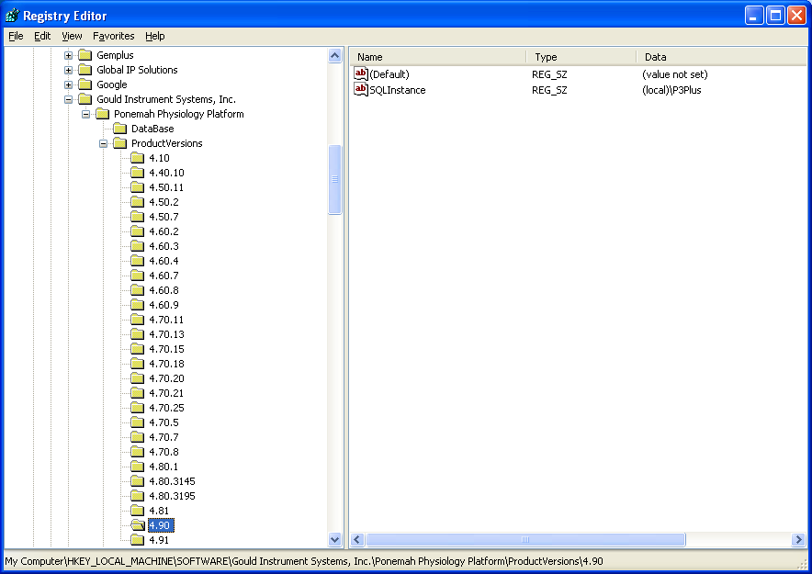
Registry Structure and Versions
Each version of Ponemah installs a new registry key.
SQLInstance key is the SQL Server location
(local)P3Plus
V4.9 or better
Use REGEDIT to access registry key – must be administrator to change!
HKEY_LOCAL_MACHINE\SOFTWARE\Gould Instrument Systems, Inc.\Ponemah Physiology Platform\ProductVersions\5.0

Slide 15
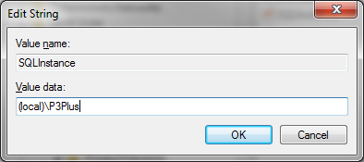
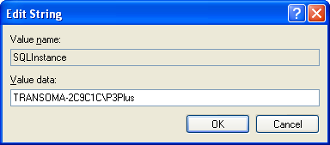
New Registry Key Setting
SQLInstance key V4.80 and prior: If renaming a workstation this key needs to be changed since it has the workstation name in it. Remove workstation name and Replace with (local).
UPDATE – V5.00 it is now np:(local)\P3Plus and it uses named pipes to avoid loss of database connectivity when the network connection is changed.
Old Entry
New Entry

Slide 16
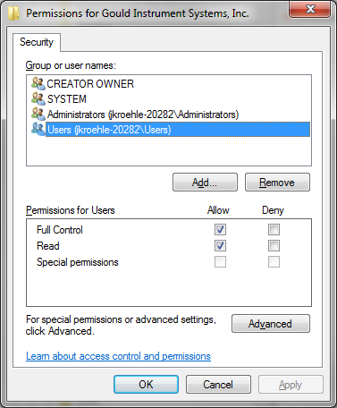
Registry Key Permissions
Users must at least have Read Permission
  DSI Reporting will not launch if the permission is not correct

Slide 17
Common Errors
Ponemah cannot create database at first startup
  User not logged on as Administrator
  SQL authentication is set to Windows Only
After ghosting an image Ponemah cannot start
  Registry key has workstation name as the SQLInstance – change to (local)
  See slide - New Registry Key Setting

Slide 18
Troubleshooting SQL
SQL Server Management Studio Express tool
  http://www.microsoft.com/download/en/details.aspx?id=8961
This tools allows looking at security, databases, tables, etc…
In Windows7 you need to Run as Administrator
  See next slide

Slide 19
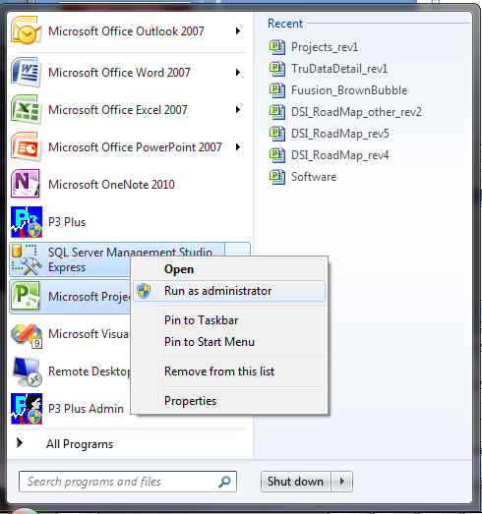
Running the tool Windows 7
Right click to display menu
Run as administrator
Otherwise certain items cannot be modified and others will be hidden

Slide 20
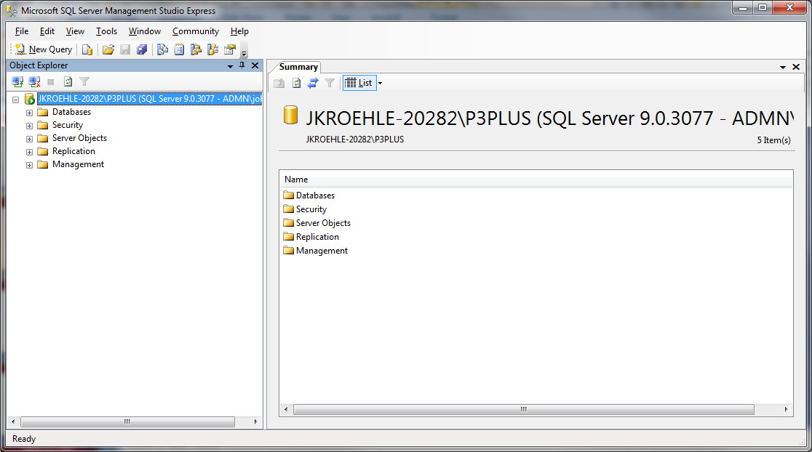
Checking SQL Authentication
Right click on server to display menu and select Properties

Slide 21
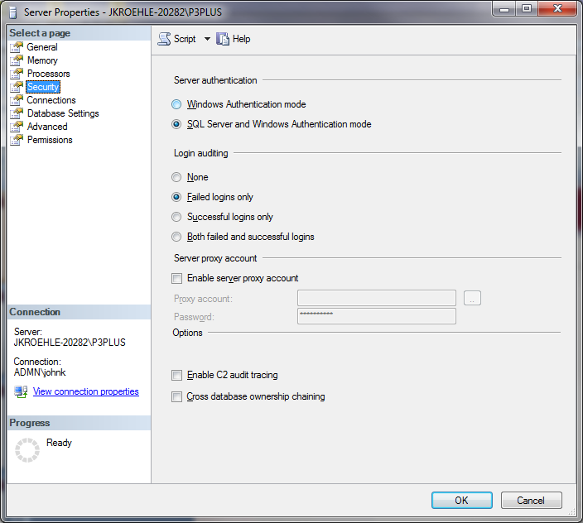
Verify SQL Authentication
Select Security
Verify that Server authentication is set to SQL Server and Windows Authentication mode

Slide 22
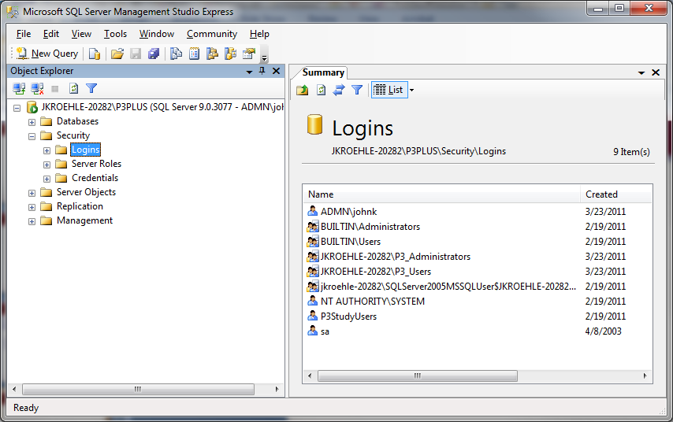
Verifying Users and Groups
Select Logins
Verify P3_Users, P3_Administrators and P3StudyUser exist
P3_Users and P3_Administrators are the groups from the Windows User and Groups
The P3StudyUsers user is only in SQL and this user has full db rights – sysadmn
When DSI Reporting is installed, P3ReportUser will be added.
Notes:
The Logins area may look different but it needs P3_Users, P3_Administrators and P3StudyUsers
If reporting has been installed there would be P3ReportUsers

Slide 23
Accessing SQL
P3_Users and P3_Administrators have public access
  Query and read only
  Other external programs can access SQL as long as the logged on user to the workstation is in P3_Users or P3_Administrators
P3StudyUsers have full db rights
  This is a SQL User – not Windows logon user
  Used internally by Ponemah application only
  Create, delete, modify…

Slide 24
Network Study Features
Multiple P3 Workstations can be defined.
  As acquisition or Post (Review).
Must be in same DOMAIN.
Can run acquisition without network connectivity.
  Reconnect to sync databases and data files.
When setting up, modifying or syncing data, all P3 Workstations must be connected to the network and on but does not need to be running P3.
Verifies that setup is consentient across all workstations – verifies setup file.
Changes to Study setup in one place – pushes out to all workstations in the Study.
Needs to work with SQL Server Database Engine!

Slide 25
How Network Study Works
Each P3 workstation is running SQL Server.
Network Study uses the workstation name along with SQL Server instance name – P3Plus or P3PlusTest.
When setting up a Study, the workstation name is what is used to update the SQL Server databases in the Study.
When syncing a Study:
  Workstation names are used to synchronize the databases.
  Shared drives are used to copy the data files.
Each Study is in a separate database.
The configuration is peer-to-peer, not client server.

Slide 26
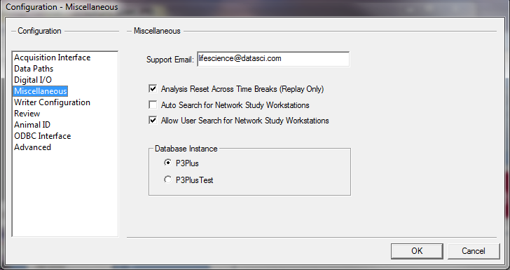
Knowing Which SQL Instance is Being Used
Can be verified in Configuration - Miscellaneous
Notes:
Studies would also be in the instance that is being used.
If a Study is created in P3Plus and then the instance changed, that study will no longer be available.
The Study would be available when switched back.

Slide 27
Network Study & DSO
Typically usage of Study is for GLP customer
  DSO will be used.
Configuration is important to properly protect workstations & data.
Folder shares need to be configured.
Users need to be in the P3_Users account.
LSS_P3_Administrator needs to be enabled.
If Firewall is on it needs to be configured.
Certain Services need to be running.

Slide 28
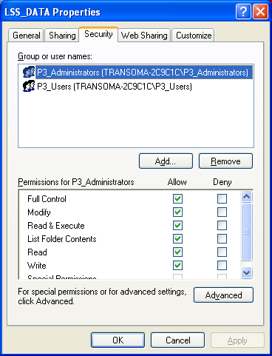
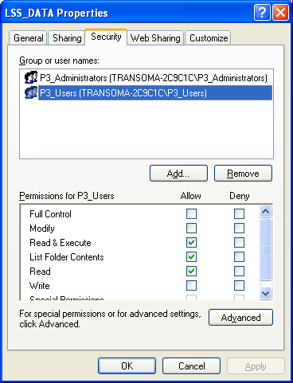
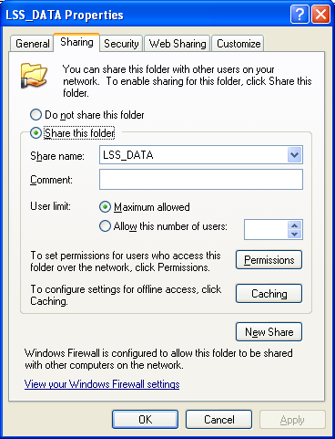
Access to Study Data Across Workstations
LSS_Data folders must be shared.
  Default is not shared.
  Can use Secure Existing Directory or Create Secure Directory in Tools.
When securing systems (DSO) the correct users are added to folder and other users are removed.
P3_Administrators
P3_Users
Folder Share

Slide 29
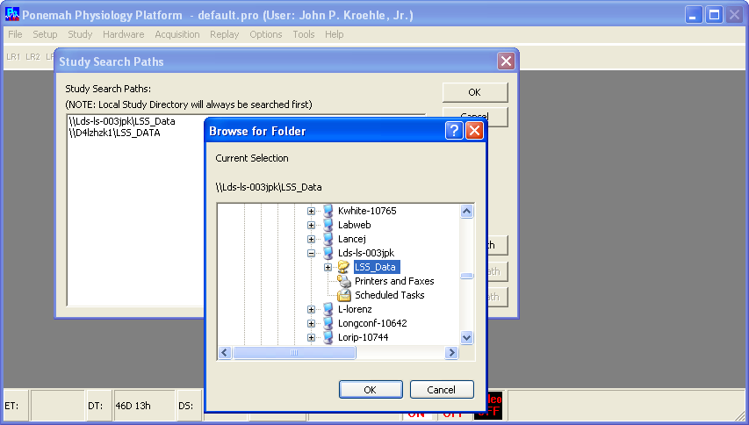
If Folder Shares not Correct
Will not be able to add Study Search Paths. Workstation can be seen but the LSS_Data folder will not.
Synchronize Entire Study will not be able to copy the binary data.
Notes:
Fie and Print sharing must also be enabled.

Slide 30
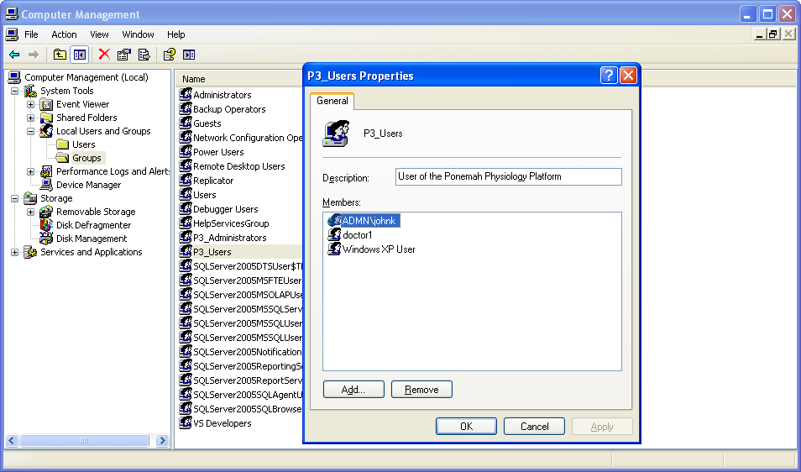
Groups & Users
P3_Users do not have delete or overwrite capability.
Users do not need to be in both groups – keep user out of P3_Administrators.

Slide 31
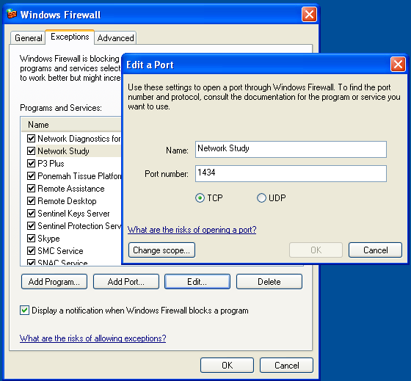
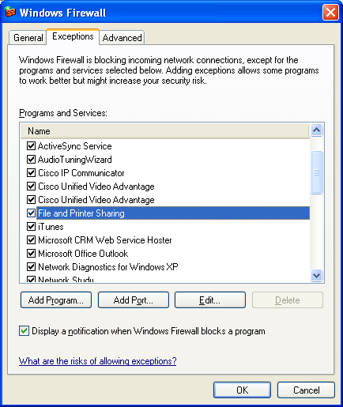
Windows XP Firewall Settings
Access Windows Firewall from Windows Control Panel
  Select Add Port
Add SQL Server Port
  TCP Port 1434 needs to be added to the exception list.
  If not set than the database will not synchronize.
Verify that File and Print Sharing is also checked in the exception list.

Slide 32
Windows 7 Firewall Settings
Access Windows Firewall from Windows Control Panel
  Advanced Settings
  Inbound Rules
  Select New Rule
    Program
    Browse to SQL executable
    C:\Program Files\Microsoft SQL Server\MSSQL.2\MSSQL\Binn\sqlserver.exe
    All domains
    Name the rule
  NOTE – Cannot use a port due to dynamic assignment (see end of slide deck)
Verify that File and Print Sharing is also checked in the exception list.

Slide 33
Needed Window Services
P3 Security
  Automatically installed and provides the DSO security functions.
Server
  Supports sharing over the network.
SQL Server (P3PLUS) or SQL Server (P3PLUSTEST)
  Provides SQL Server functionality to the application. If disabled Ponemah will not function.
Others…
  Each security type application can have its own list of configuration issues.

Slide 34
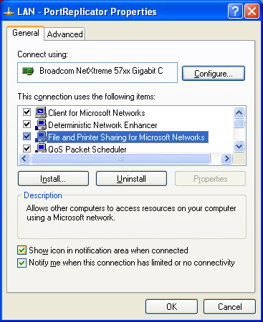
Network Protocol
File and Print Sharing protocol must be installed and enabled.
  Will not be able to Browse and see shared folders.
  Access this through you network interface properties.
  Need administrator rights to change.

Slide 35
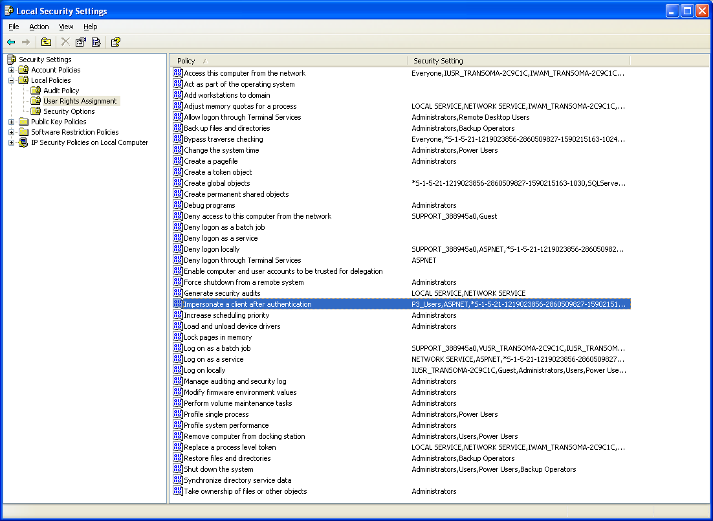
Local Security Polices
Impersonate a client after authentication
  P3_Users are added to the policy so that the user does not need administrator rights, the application handles this and a P3_Users becomes LSS_P3_Administrator
Notes:
Note that when reconnected to a domain these polices can change.

Slide 36
Other Security Considerations
These applications may interfere with
  Folder sharing across the network
  Blocking SQL Ports
  Blocking other polices
Applications of Interest
  Virus checkers
  Spam Blockers

Slide 37
Getting Databases for Support
P3Plus or P3PlusTest Databases
  Must turn off the SQL Service.
  Copy the desired P3Plus_xxx.MDF and the corresponding P3Plus_xxx_Log.ldf files and have these files sent to DSI.
  Can then copy to a support workstation.
Study Database
  Use Backup feature within Study.
  Can restore the backup file in Support.
Notes:
The xxx are the version of Ponemah that is installed and being used.

Slide 38
Study Support Issues
Difference in licensed algorithms.
  Failures can happen if an algorithm is on one system but not the other one being synced.
Changing of algorithm derived parameters list from an updated analysis module in the middle of a study.

Slide 39
Setting Up a Network Study – An Overview

Slide 40
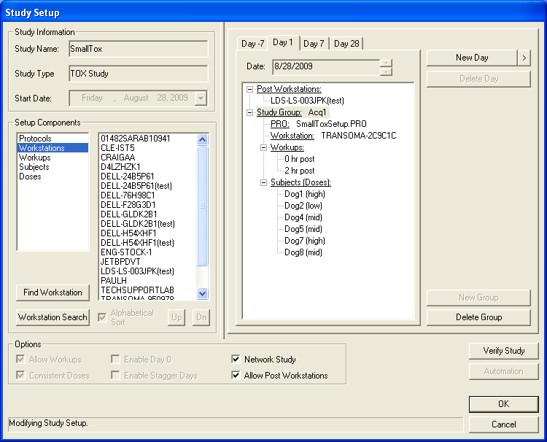
Tox with Study Networking
Post Workstations
Network Study Feature

Slide 41
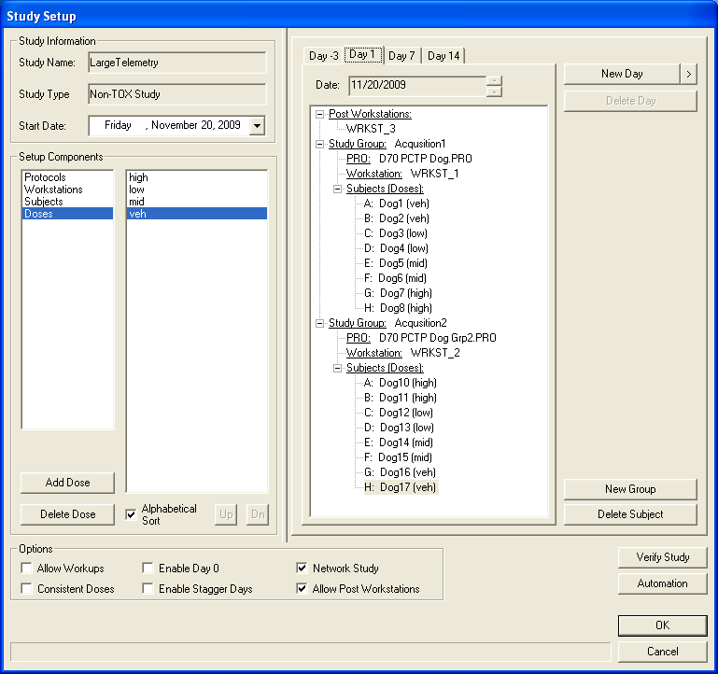
Non-tox with Network Study
Network Study Feature

Slide 42
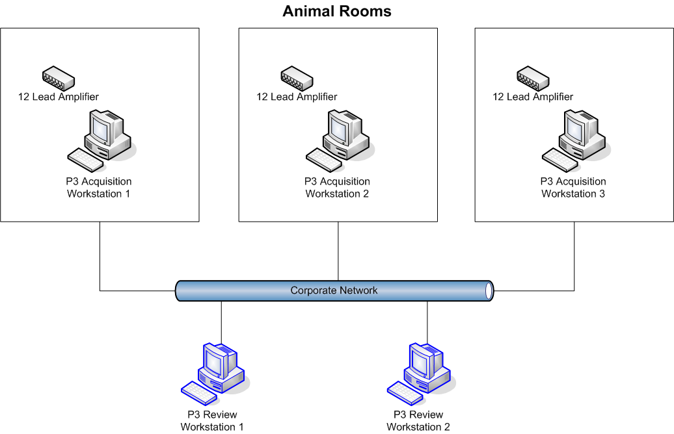
Tox Study Networked

Slide 43
Typical Setup & Usage
Define Study on Post workstation
  Could be acquisition
Connect all workstations in Study to the network.
When user closes dialog, all workstations updated with Study information.
Disconnect from network if needed.
Run acquisitions.

Slide 44
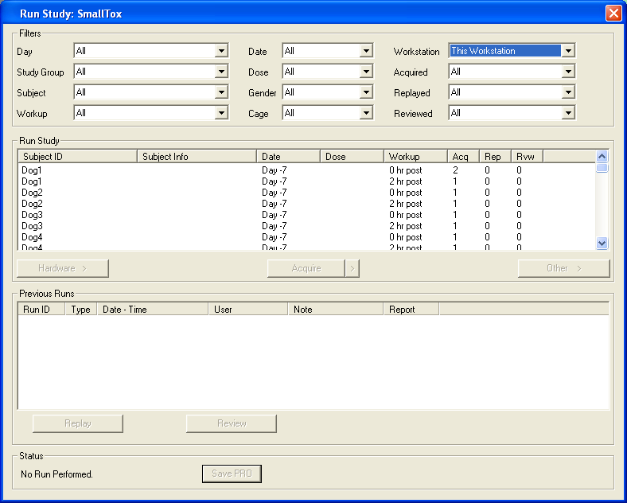
Run Study
Workstation Filter – only allows the user to collect data assigned to this workstation.
Workstation Filter

Slide 45
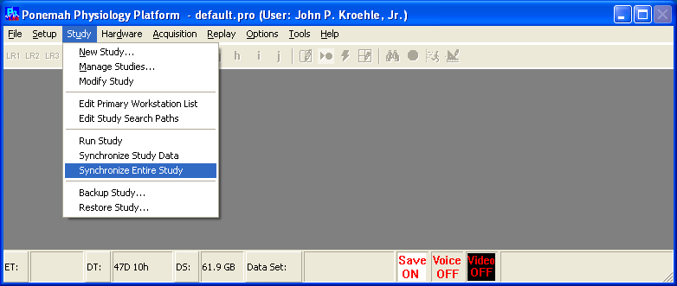
Consolidating Study Data
Assure all workstations powered on and connected to network.
  Do not need to be logged in.
From the Post workstation, Synchronize Entire Study.
Updates all Study workstations databases with latest information.
Copies all data files to the Post Study directory.

Slide 46
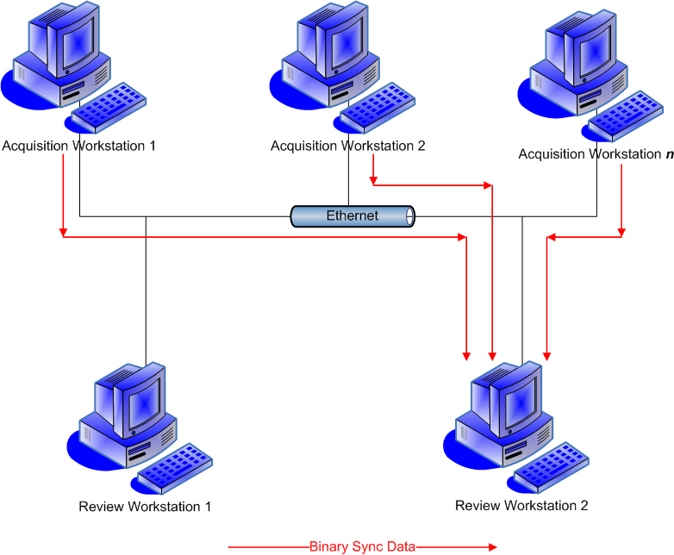
Data Flow Diagram
Only the workstation that started the synchronization will have all the binary data on it (red lines in diagram) even if other Review Stations are part of the study.
All workstations database will be updated will all information.

Slide 47
Backing Up Study Data
Perform Study Backup
  This backs up the database.
  Can be to a mapped drive.
Data Manager
  Moves all data files to an archive.

Slide 48
Restoring Study Data
Restore Study database.
Data Manager retrieves files back from archive.
  Reviews can then be performed.
Issue For Support: When backing up from an older version that backup file can be restored on a newer version of the application. Once that action occurs the study database can no longer be used in the older version!

Slide 49
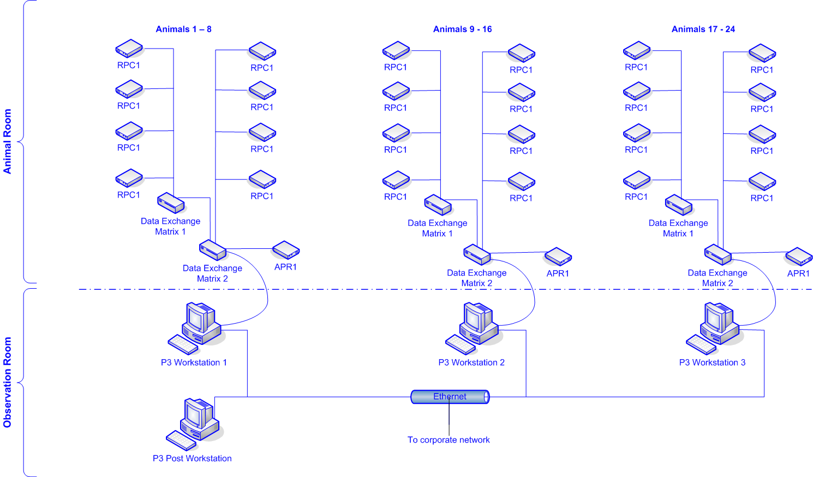
Another Example - Telemetry Setup

Slide 50
Notes
Dynamic Ports
By default, named instances (including SQL Server Express) use dynamic ports. That means that every time that the Database Engine starts, it identifies an available port and uses that port number. If the named instance is the only instance of the Database Engine installed, it will probably use TCP port 1433. If other instances of the Database Engine are installed, it will probably use a different TCP port. Because the port selected might change every time that the Database Engine is started, it is difficult to configure the firewall to enable access to the correct port number. Therefore, if a firewall is used, we recommend reconfiguring the Database Engine to use the same port number every time. This is called a fixed port or a static port. For more information, see Configuring a Fixed Port.
An alternative to configuring a named instance to listen on a fixed port is to create an exception in the firewall for a SQL Server program such as sqlservr.exe (for the Database Engine). This can be convenient, but the port number will not appear in the Local Port column of the Inbound Rules page when you are using the Windows Firewall with Advanced Security MMC snap-in. This can make it more difficult to audit which ports are open. Another consideration is that a service pack or cumulative update can change the path to the SQL Server executable which will invalidate the firewall rule.

Slide 51
Windows 7 Firewall Settings References
http://msdn.microsoft.com/en-us/library/ms175043.aspx
http://jwwishart.wordpress.com/2009/10/27/firewall-rule-for-sql-server-2005-on-windows-7/
http://msdn.microsoft.com/en-us/library/cc646023.aspx

